Slide 1
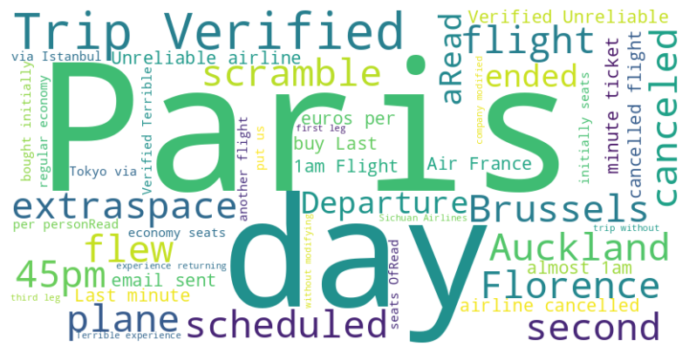
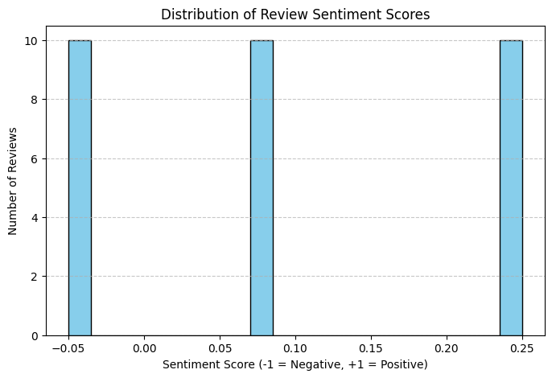
"Customer Feedback Analysis – British Airways"
Summary of Insights
• High overall satisfaction with positive sentiment scores.
• Frequent praise for cabin crew and service quality.
• Top complaints include flight delays, food quality, and seating comfort.
• Most feedback centers around travel experience and customer service.
• Sentiment distribution shows mostly positive experiences.
Distribution of Review Sentiment

